Slide 1




Prompt to Product:
Scaling AI

Slide 2
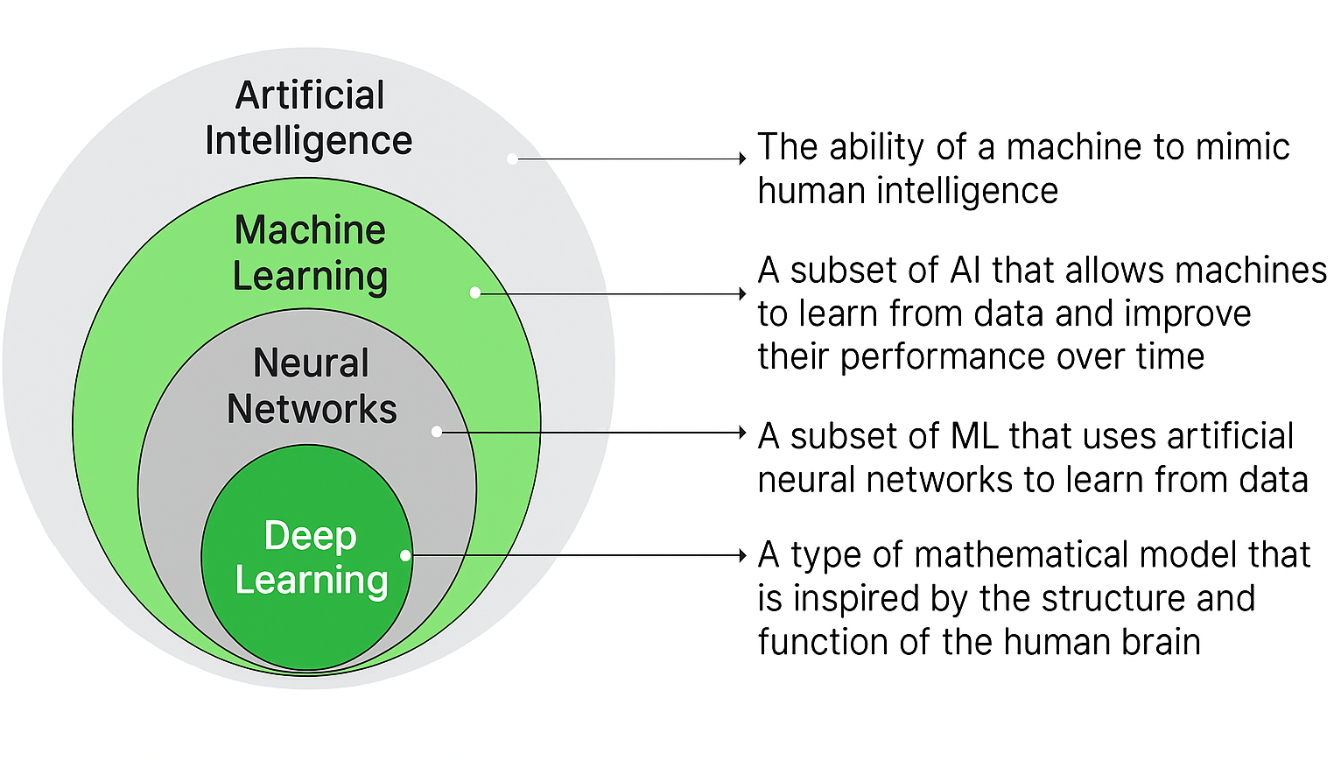



Title

Slide 3

Title
Prompts
Prompting acts as a bridge - human goals and machine responses
Get prompting right and you can build remarkable products with off-the-shelf models.
Get it wrong, and even the most advanced custom models will disappoint

Slide 4
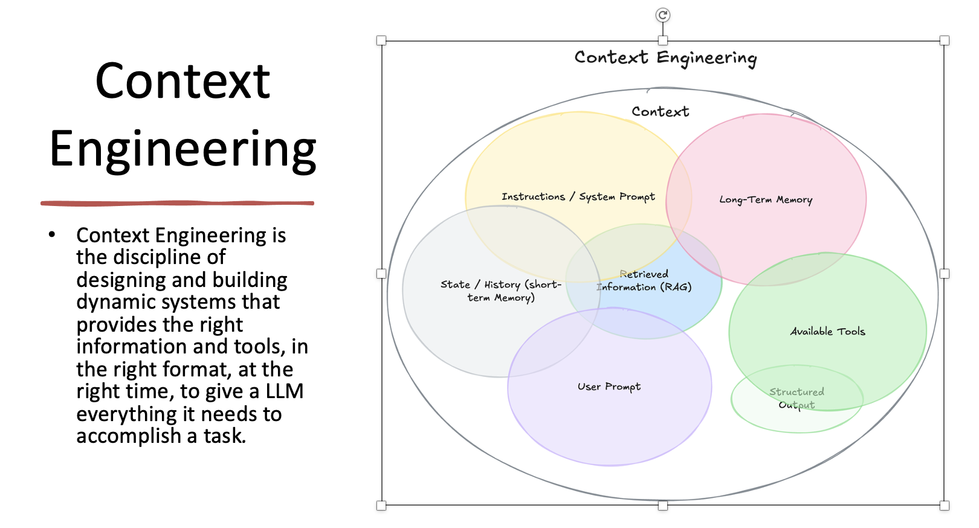
Title

Slide 5
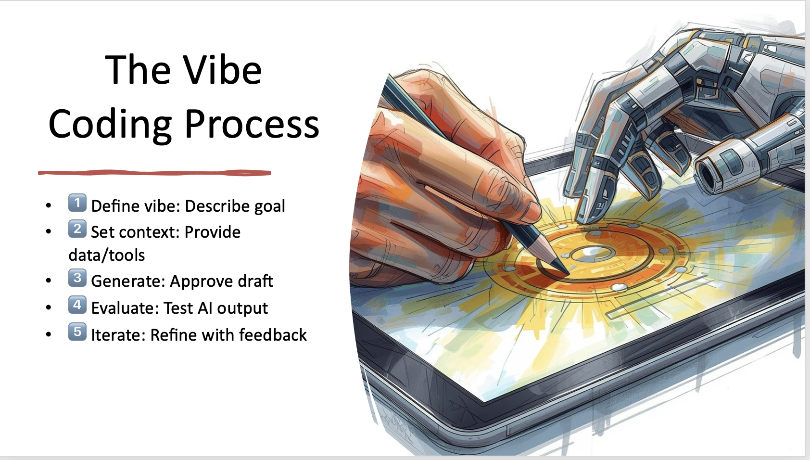
Title

Slide 6
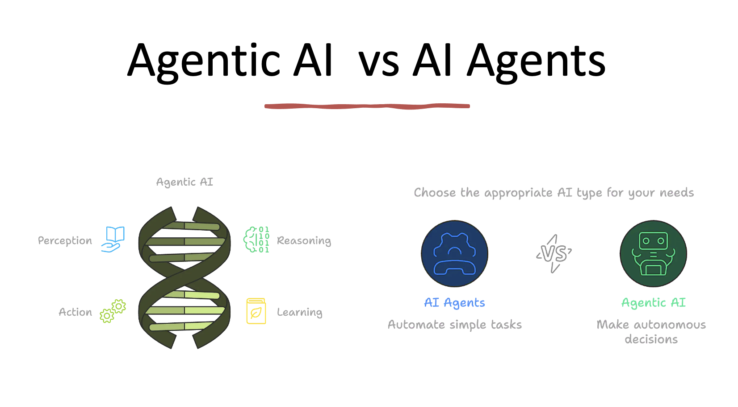
Title

Slide 7
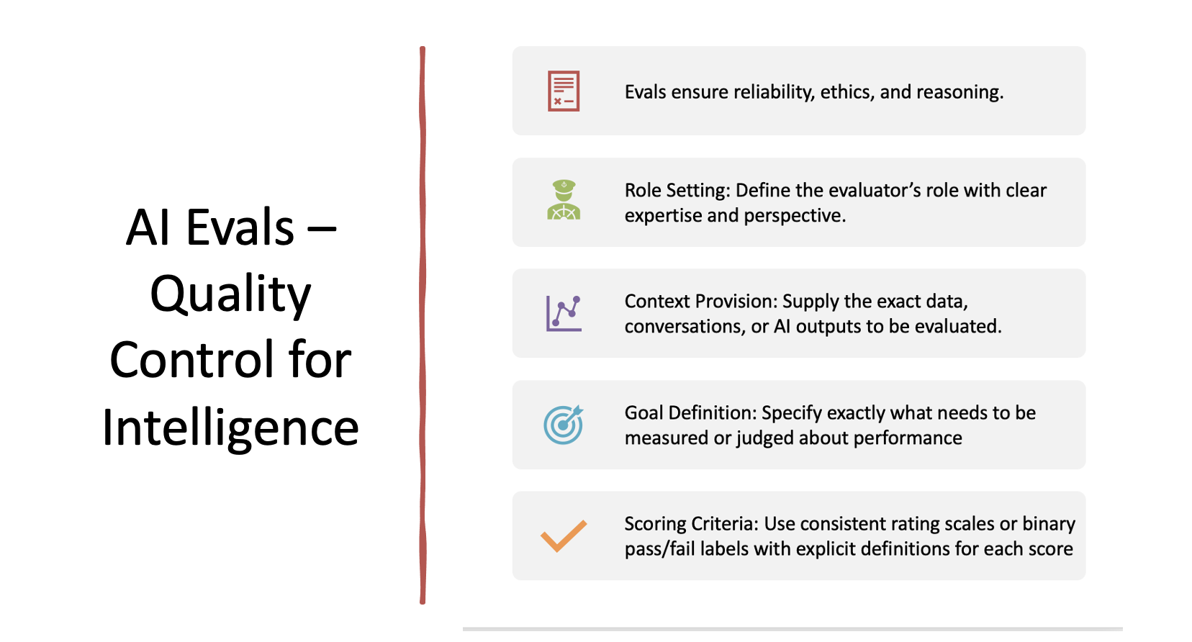
Title

Slide 8
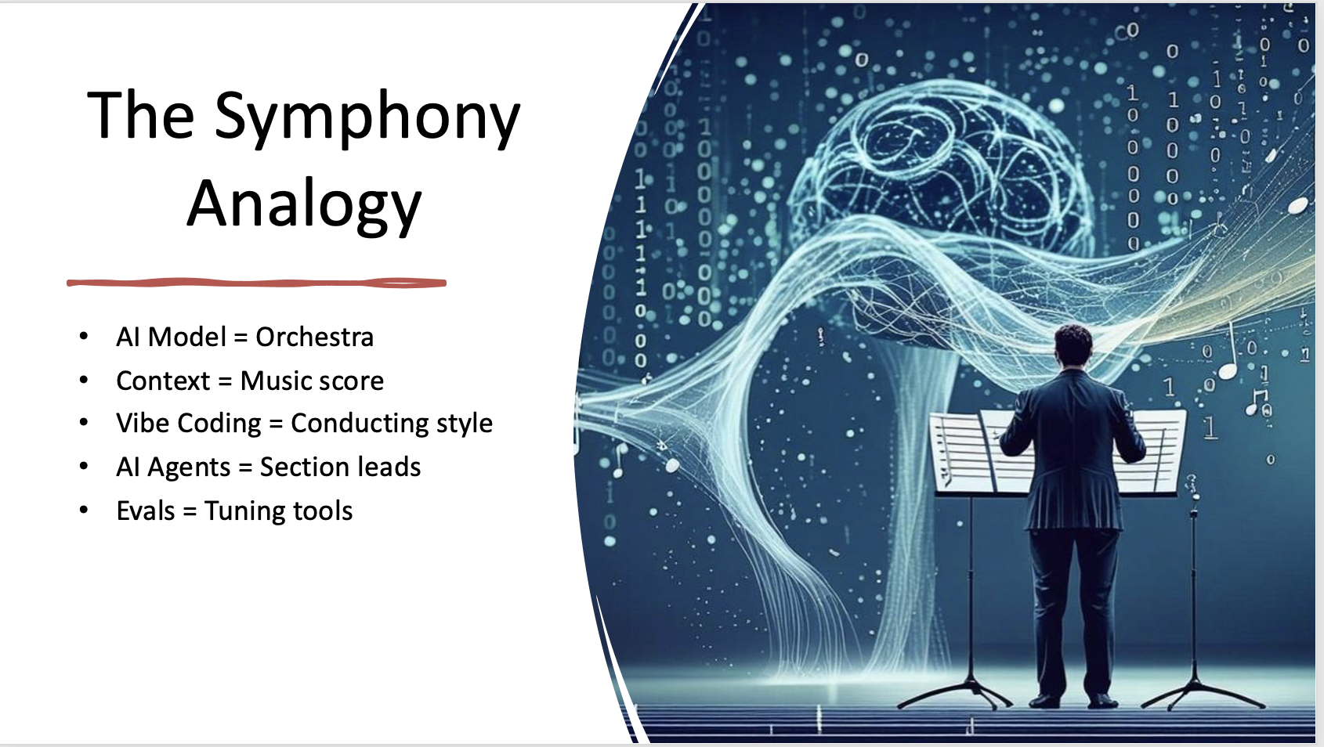
Title

Slide 9
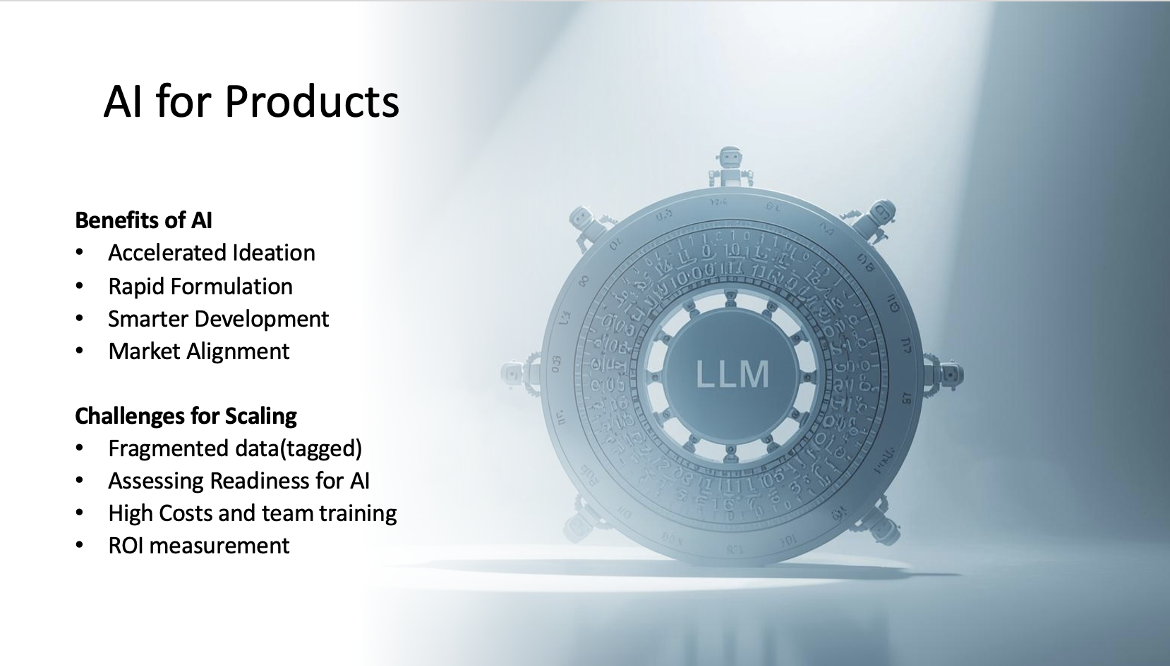
Title

Slide 10
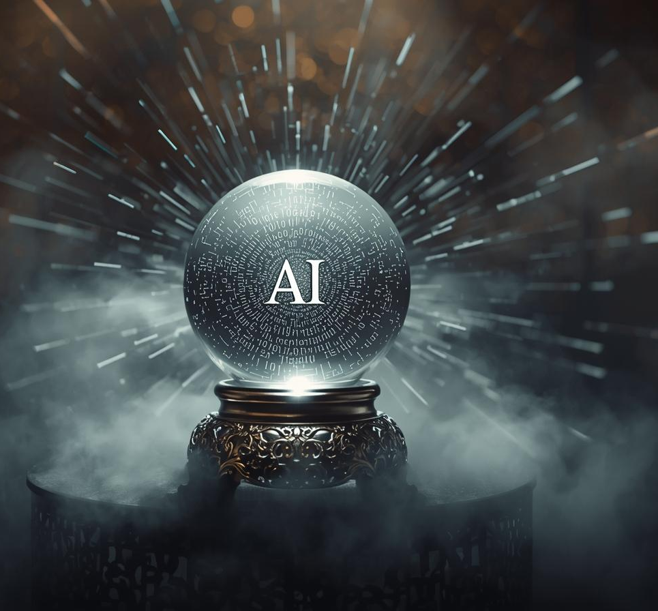
Title
"I believe in the future of AI changing the world. The question is, who is changing AI? It is really important to bring diverse groups of students and future leaders into the development of AI”– Fei-Fei Li
( the inventor of ImageNet and the ImageNet Challenge, a critical large-scale dataset and benchmarking effort that has been widely regarded as one of the three driving forces of the birth of modern AI and deep learning revolution)

Slide 11
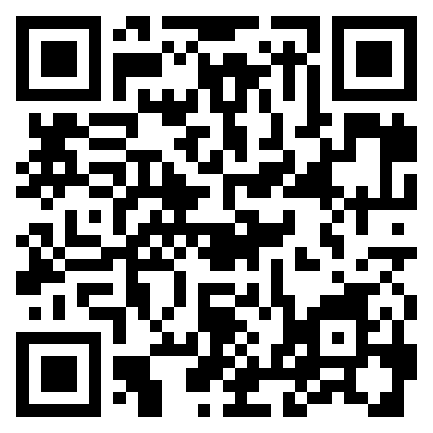
Title
Would love to continue sharing perspectives and learning together…..
Connect with me on :
LinkedIn

